Slide 1
VAT IC2 Controller Generation
Leo Marugg
22.08.2013

Slide 2
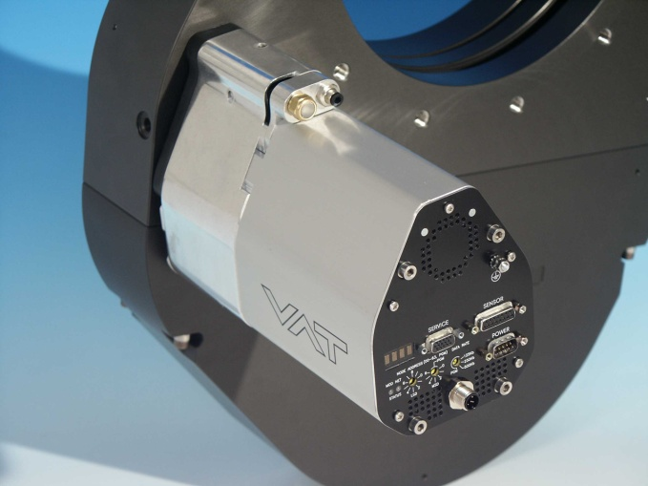
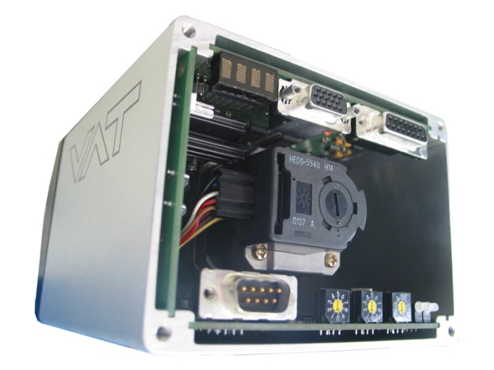
Background
Actual IC Controller Platform
12 year old design
Some components are reaching end of the lifecycle → difficult component supply
Computing power of 16Bit CPU → Limitation for improving software performance
Fieldbus integration → Expensive solution with OEM-modules
Drive technology → Limited dynamics with present technology
High manufacturing cost → Some expensive components → Logistic costs due to high number of HW-versions

Slide 3
Target for new Controller Generation
Main topics
Use of latest electronics technology → assures supply security
32Bit CPU technology → Improved computing power for future software developments
Chip based fieldbus integration → Lower cost for fieldbus interfaces
Field orientated drive technology → higher dynamics and more efficient drives
USB service port → Actual Laptop PC can be uses without Adapter
New modular system → reduce logistic cost
VAT wide controller concept → Concept can also cover non control valve applications

Slide 4

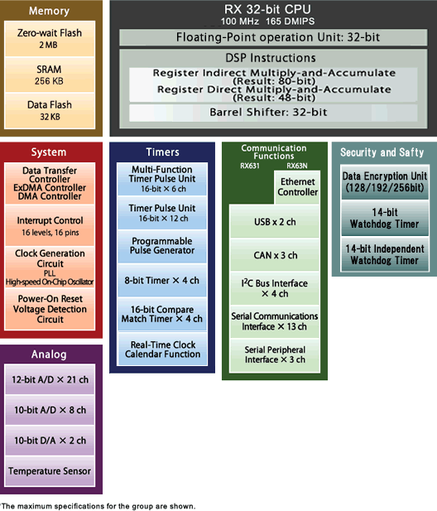
CPU
New 32 Bit CPU
Renesas (JP)
RX600 Family
R63N
Main Features - 100 MHz clock frequency - 1 Mbyt Flash (program code) - 128 kbyte RAM (data memory) - 32 kbyte EEPROM (non volatile memory) - Integrated USB communication unit - up to 13 integrated serial communication units (SPI,RSPI, UART, I2C, CAN, …) - Integrated A/D, D/A converters - Integrated temperature sensor

Slide 5
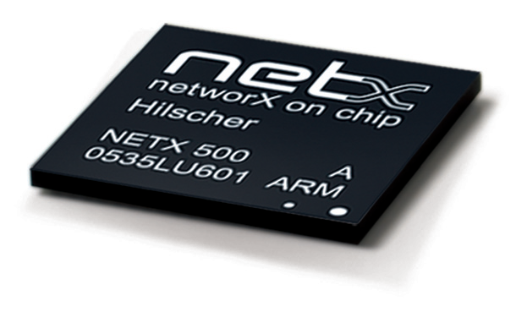
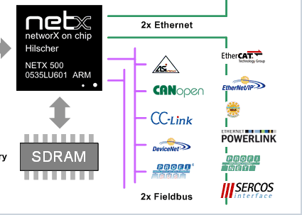
Fieldbus Integration
netX52
Hilscher (D)
netX Family
netX52
Supported fieldbuses - EtherCAT - DeviceNet - CC-Link - Profibus - …
Advantages for VAT - Easy to integrate - Low cost

Slide 6
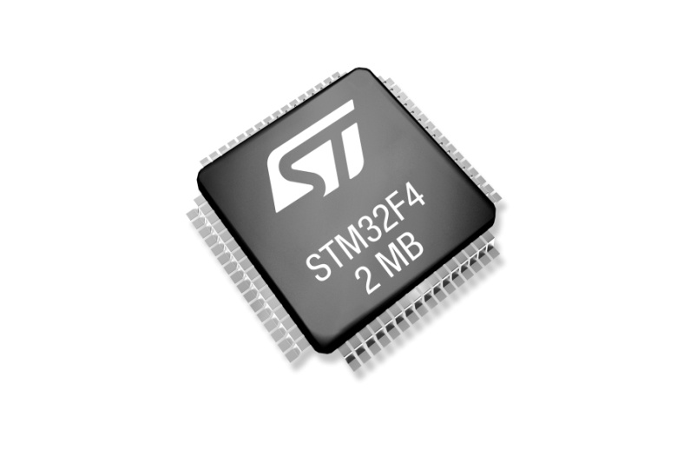
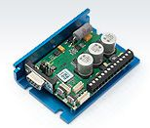
Motor driver
Nanotec Motion Controller
Standard 32bit micro controller
Nanotec firmware
Field orientated motor control ● High peek torque ● High dynamic (speed, acceleration) ● low power consumption ● torque control ● Load feedback ● smooth movement
Two axes synchronized motion
Advantages for VAT - Easy to integrate - Low cost

Slide 7
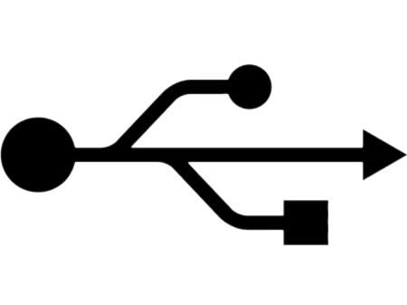
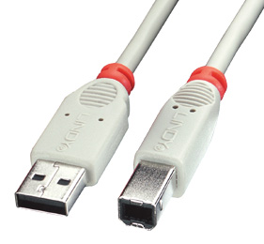
USB Service Interface
USB 2.0 with type B connector
Functionality ● Local control ● Setup ● Diagnostic ● Firmware download (controller, CPA, motion controller, netX)
CPA ● Software stored in controller ● Automatic upload and start after PC-connection ● No installation on PC required ● CPA automatically adapts to controller firmware functionality

Slide 8
Power Connector
Funktion | Pin |  | Funktion | Regelventil | Isolationsventil
+24V | 1 |  |  | X | X
 |  | 9 | +15V | X
+24V | 2 |  |  | X | X
 |  | 10 | -15V | X
GND | 3 |  |  | X | X
 |  | 11 | Input Enable (HW) | X | X
GND | 4 |  |  | X | X
 |  | 12 | Input Open | X | X
Output Open | 5 |  |  | X | X
 |  | 13 | Input Close | X | X
Output Closed | 6 |  |  | X | X
 |  | 14 | Input Common (VC) | X | X
Output Common | 7 |  |  | X | X
 |  | 15 | Reserve | Opt. | z.B. Input 3
Reserve | 8 |  |  | Opt. | z.B. Input 4

Slide 9
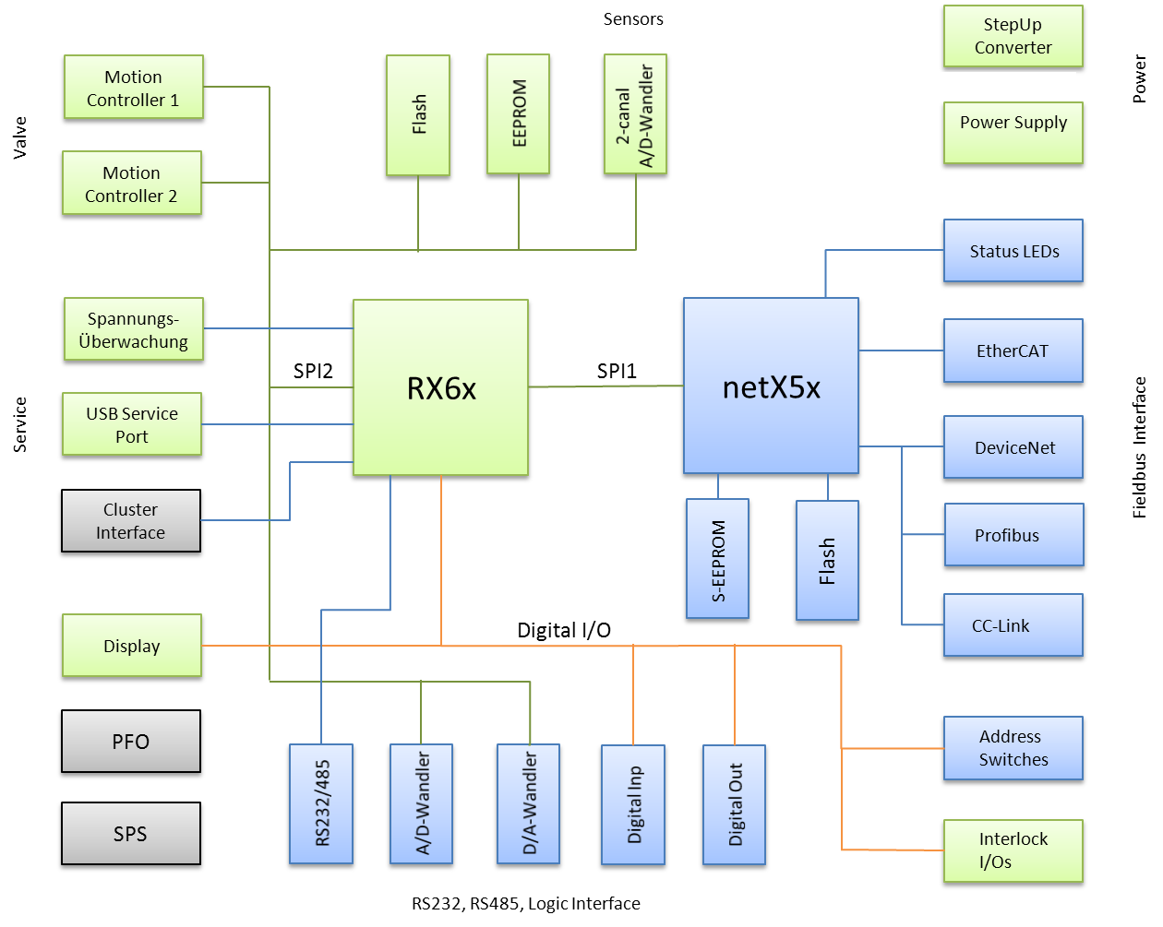
Block Diagram

Slide 10
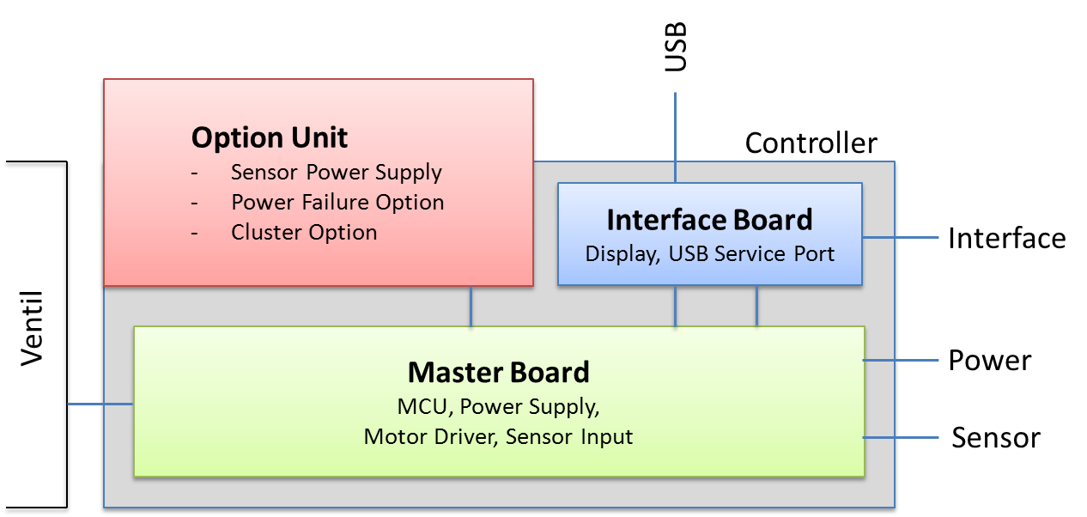
Basic Concept

Slide 11
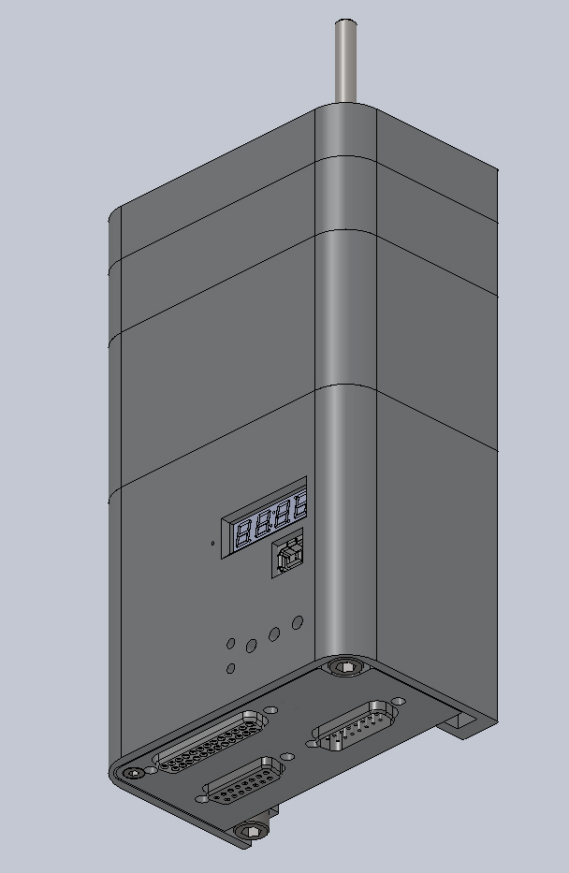
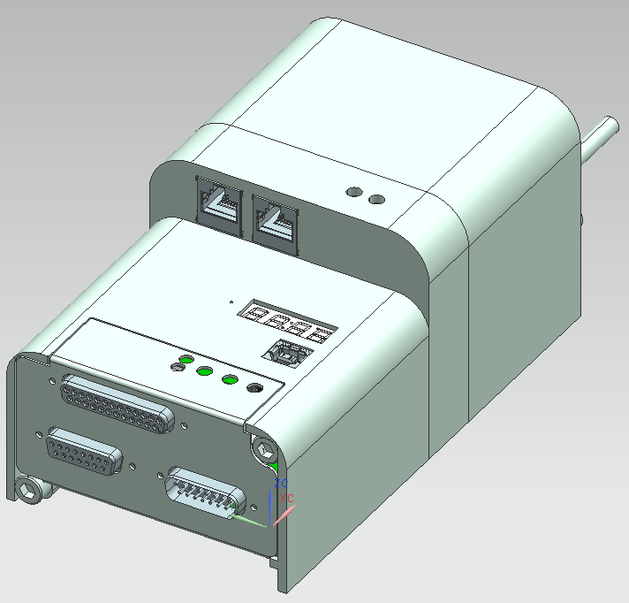
Mechanical Design

Slide 12
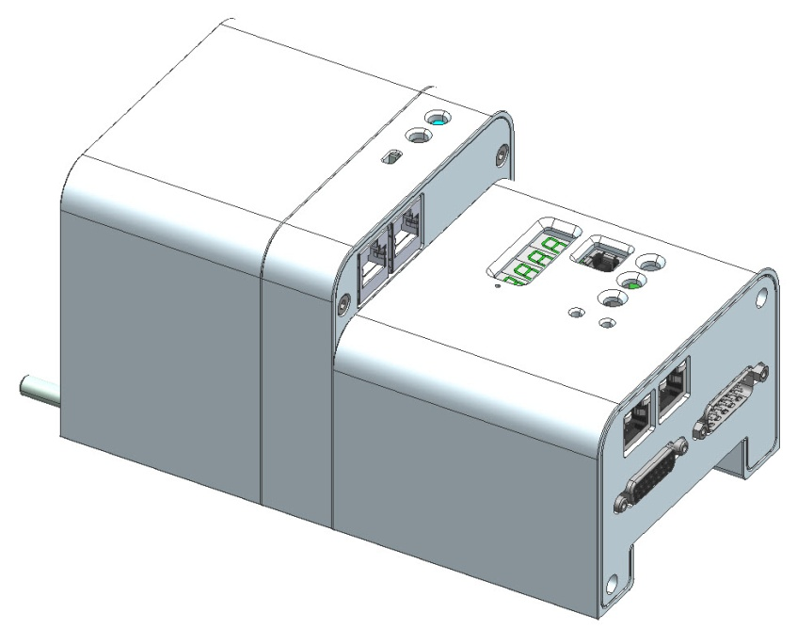
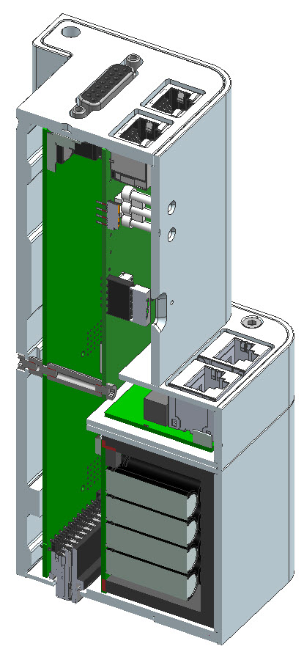
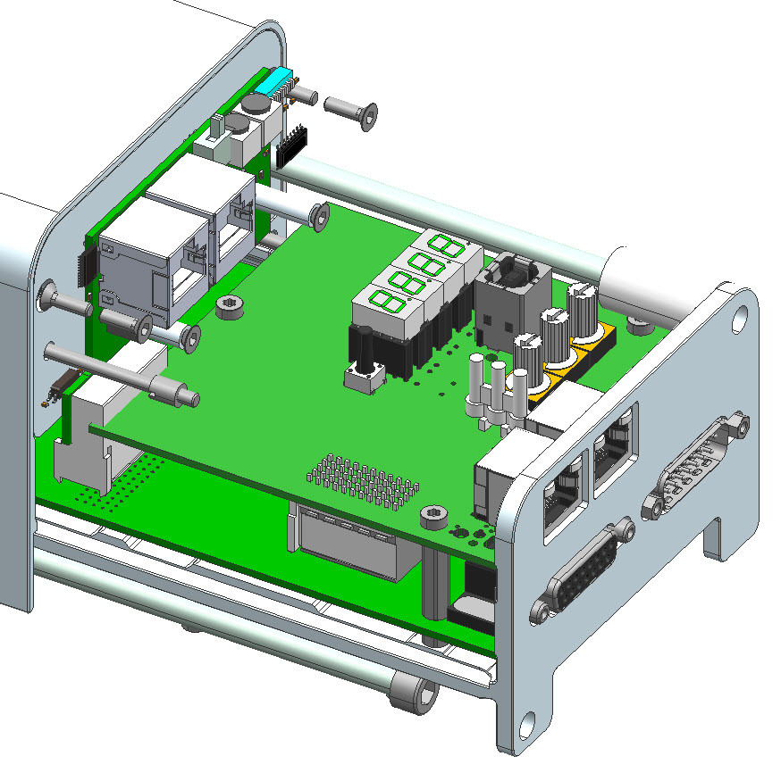
Mechanical Design

Slide 13
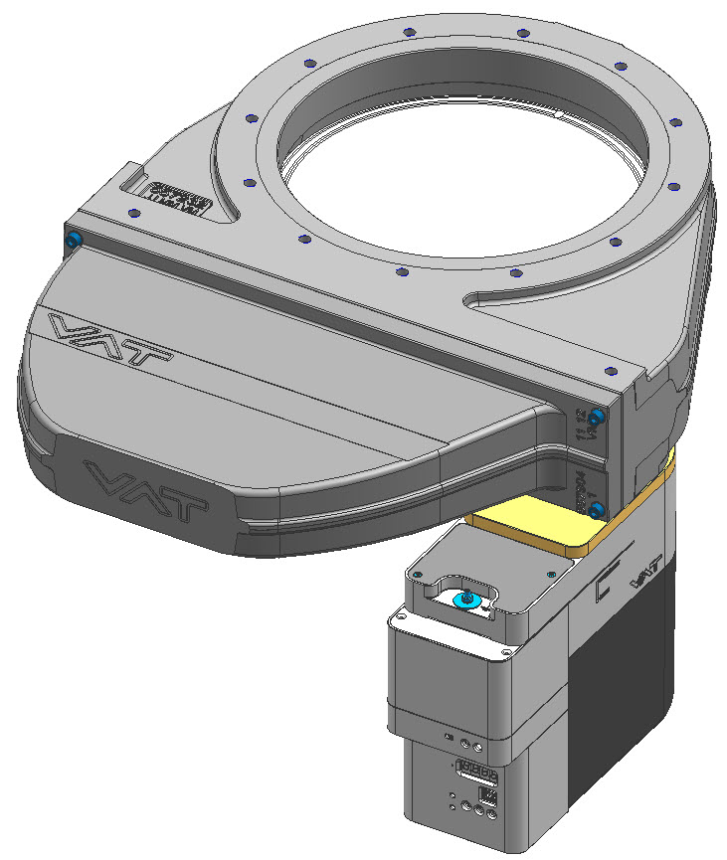
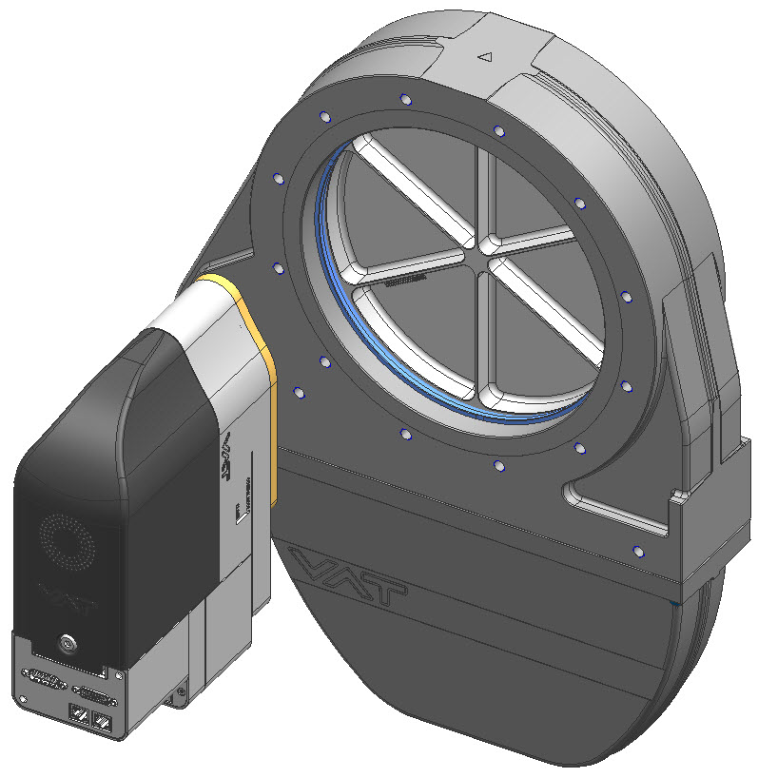
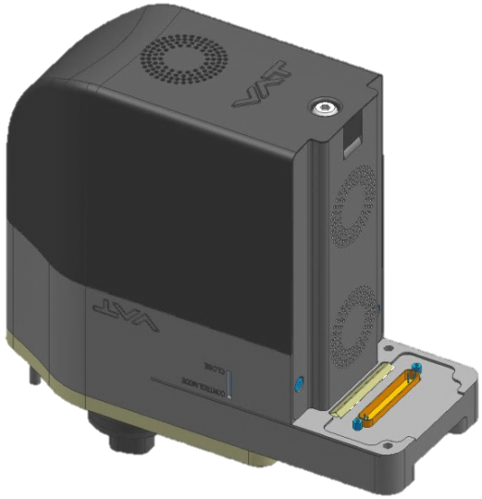
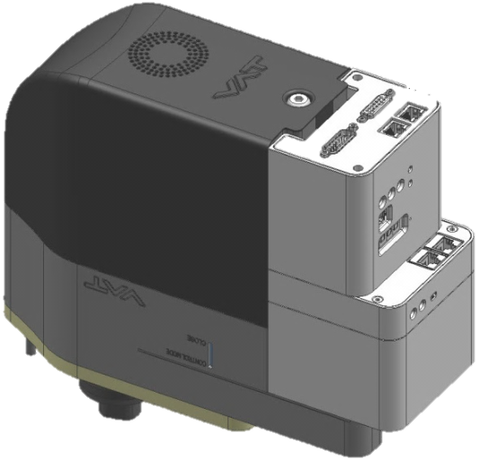
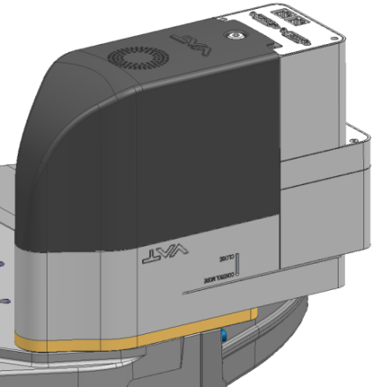
Mechanical Design

